Slide 1



AI-INTEGRATED HOME AND COMMUNITY PROTECTION SYSTEM SUPPORT SDG 11
Project Coordinator: Arun M
Thanush K - 211191101159
Project Guide: Ms.A.MAHESWARI
Santhosh R - 211191101131
Pious Niranjan
Dhanush Raj

Slide 2

ABSTRACT
The AI-integrated home and Community Protection System is designed to enhance community safety and resilience by leveraging advanced AI and civil engineering principles. This system involves the installation of smart devices in individual homes throughout a community, each equipped with feature buttons and voice commands to address critical emergencies: theft, medical incidents, fire, and air quality issues. In an emergency, residents can trigger the system using a designated button or voice command, which activates a siren in all devices within a 1 km radius, alerting neighbors to the specific type of emergency and its location. Simultaneously, automated messages and calls are sent from a central server to relevant authorities, such as police, ambulance services, or fire departments, ensuring a swift response. Its serialized LAN connection further enhances The system's robustness, which guarantees uninterrupted communication even if one network line is compromised. By fostering collaboration among community members and enabling rapid emergency response, this project aims to create safer, more sustainable urban environments in alignment with Sustainable Development Goal 11.
KEYWORDS: AI-Integrated Systems, Community Protection, SDG 11, Emergency Response, LAN Network, Smart Home Technology, Urban Sustainability
1159- Thanush
1131- Santhosh
AI-INTEGRATED HOME AND COMMUNITY PROTECTION SYSTEM SUPPORT SDG 11
2/17

Slide 3
INTRODUCTION
Objective: Address urban safety challenges with advanced technology integration.
System Overview:
Smart Devices: Installed in homes, equipped with buttons and voice commands for quick emergency activation.
AI-Driven Response: Automates alerts and notifications to neighbors and authorities within a 1 km radius.
Key Innovations:
Serialized LAN Network: Ensures uninterrupted communication even if part of the network is compromised.
Multi-Emergency Management: Handles theft, medical incidents, fire, and air quality issues.
Impact:
Community Resilience: Strengthens collective safety and rapid response.
Sustainability: Contributes to safer urban environments in line with SDG 11
1159- Thanush
1131- Santhosh
AI-INTEGRATED HOME AND COMMUNITY PROTECTION SYSTEM SUPPORT SDG 11
3/17

Slide 4
LITERATURE SURVEY
Table. No.1
S.NO | AUTHORS | METHOD USED | METHOD DESCRIPTION | YEAR
1 | Abubaker Sherif [Et.,al] | Long Range (LoRa) wireless communication, panic button, embedded sensors, mobile and web applications | Development of a LoRa-driven home security system for a retirement township, with manual and automatic alerts and security management features | 2019
2 | Md Eshrat E. Alahi [Et.,al] | IoT-enabled technologies, Artificial Intelligence (AI), 5G networks, communication technologies | Review of IoT and AI integration for smart cities, covering wireless communication technologies, AI algorithms, and their potential impact on urban environments | 2023
3 | Md Eshrat E. Alahi [Et.,al] | Internet of Things (IoT), wireless communications, networking technologies | Introduction of the smart community concept, including secure networking among smart homes and applications like Neighborhood Watch and Pervasive Healthcare. | 2021
1159- Thanush
1131- Santhosh
AI-INTEGRATED HOME AND COMMUNITY PROTECTION SYSTEM SUPPORT SDG 11
4/17

Slide 5
4 | Rui Yu, Minyuan Zhang[Et.,al] | IoT security analysis, smart home security, malware detection, router-based system | Smart home security system for detecting and defending against contactless attacks with minimal network impact; future plans include machine learning integration for enhanced anomaly detection. | 2021
5 | Vijaya Bhasker Reddy[Et.,al] | AI algorithms, Arduino controller, electronic sensors | Discusses integrating AI with IoT for home automation using sensors connected to an Arduino controller. The system automates appliances like fans, doors, and water pumps based on environmental data. | 2024
6 | Mageshkumar Naarayanasamy Varadarajan [Et.,al] | AI algorithms, IoT sensors, data analysis | Explores integrating AI with IoT for smart home automation, focusing on AI's role in analyzing IoT sensor data to automate tasks, improve energy management, and enhance security, while addressing challenges like privacy and interoperability. | 2024
7 | Jinsoo Han[Et.,al] | Home-to-home (H2H) communication, wireless communication, centralized and distributed architectures | The paper compares centralized and distributed H2H communication architectures for smart communities, using clustering to reduce traffic and improve reliability. | 2017
1159- Thanush
1131- Santhosh
AI-INTEGRATED HOME AND COMMUNITY PROTECTION SYSTEM SUPPORT SDG 11
5/17

Slide 6
PROBLEM STATEMENT
Urban Safety Challenges: Traditional emergency response systems in rapidly urbanizing areas often face delays and communication breakdowns, leading to increased risks and damages.
Fragmented Emergency Responses: Lack of coordination among community members and authorities exacerbates the situation during emergencies.
Technological Gaps: Existing safety measures fail to leverage modern technologies like AI and IoT, resulting in inefficient and slow emergency management.
Need for Resilience: Communities require a robust, interconnected system that can provide real-time monitoring, swift alerts, and coordinated responses to various emergencies.
1159- Thanush
1131- Santhosh
AI-INTEGRATED HOME AND COMMUNITY PROTECTION SYSTEM SUPPORT SDG 11
6/17

Slide 7
PROPOSED SYSTEM
AI-Integrated Protection: The AI-Integrated Home and Community Protection System leverages advanced AI and IoT technologies to enhance community safety and emergency response.
Smart Devices: Equipped with feature buttons and voice commands for theft, medical, fire, and air quality emergencies, these devices are installed in homes across the community.
Real-Time Alerts: In the event of an emergency, the system triggers coordinated alerts within a 1 km radius, using sirens, lights, and automatic notifications to relevant authorities.
Serialized LAN Network: Ensures continuous communication even if one network line is compromised, providing a reliable and resilient emergency response system.
Community Collaboration: The system fosters cooperation among community members and authorities, reducing response times and improving overall safety.
1159- Thanush
1131- Santhosh
AI-INTEGRATED HOME AND COMMUNITY PROTECTION SYSTEM SUPPORT SDG 11
7/17

Slide 8
HARDWARE & SOFTWARE REQUIREMENTS
HARDWARE REQUIREMENTS:
Smart Devices: IoT-enabled devices with feature buttons, voice command capabilities, and sensors for fire and air quality.
LAN Networking Equipment: Serialized LAN cables and routers for maintaining communication across the community network.
Sensors: Air quality sensors, for real-time monitoring.
Siren and Light Systems: Installed in homes for alerting community members during emergencies.
Arduino or Similar Microcontrollers: For controlling and managing IoT devices
SOFTWARE REQUIREMENTS:
AI Algorithms: For analyzing sensor data and triggering appropriate responses.
IoT Management Platform: For integrating and managing all smart devices and sensors in the network.
Embedded System Software: For running real-time operations on microcontrollers like Arduino, enabling communication between sensors and the control system.
Networking Protocols: Such as MQTT or CoAP, for secure and efficient communication between devices within the LAN network.
Mobile & Web Applications: For monitoring system status, receiving alerts, and controlling devices remotely.
1159- Thanush
1131- Santhosh
AI-INTEGRATED HOME AND COMMUNITY PROTECTION SYSTEM SUPPORT SDG 11
8/17

Slide 9
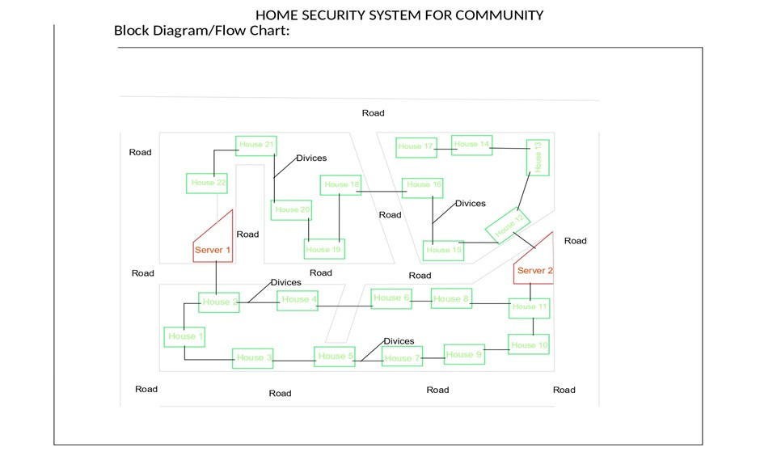
ARCHITECTURE DIAGRAM
Fig. No.1. Architectural Diagram of community
1159- Thanush
1131- Santhosh
AI-INTEGRATED HOME AND COMMUNITY PROTECTION SYSTEM SUPPORT SDG 11
9/17

Slide 10
OVERVIEW OF PROJECT
Purpose: Enhance community safety and resilience in urban areas.
Problem: Traditional emergency responses are often delayed and lack effective communication.
Solution: AI-Integrated Home and Community Protection System.
Key Features:
Real-time monitoring and alerting for emergencies.
Smart devices with specific buttons and voice commands for Theft, Medical, Fire, and Air Quality emergencies.
Coordinated response within a 1 km radius, involving neighbors and authorities.
Serialized LAN network for reliable communication even if one line is compromised.
Impact: Contributes to safer, more sustainable urban environments; supports UN SDG 11.
1159- Thanush
1131- Santhosh
AI-INTEGRATED HOME AND COMMUNITY PROTECTION SYSTEM SUPPORT SDG 11
10/17

Slide 11
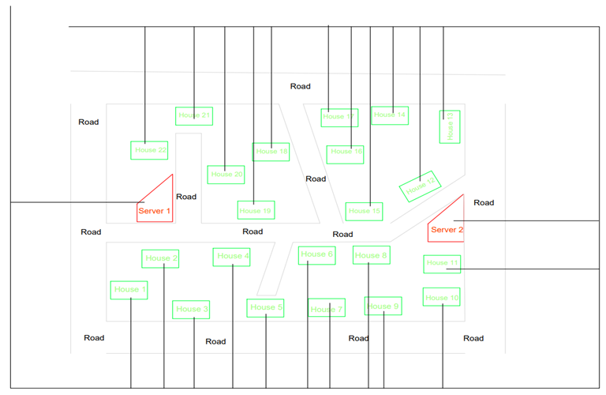
OUTPUT
Fig. No.2. Server Room
1159- Thanush
1131- Santhosh
AI-INTEGRATED HOME AND COMMUNITY PROTECTION SYSTEM SUPPORT SDG 11
11/17

Slide 12
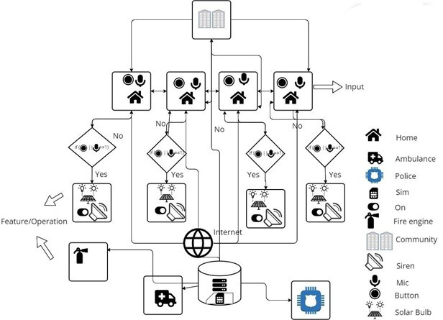
Work Flow DIAGRAM
Fig. No.3. Work Flow Diagram
1159- Thanush
1131- Santhosh
AI-INTEGRATED HOME AND COMMUNITY PROTECTION SYSTEM SUPPORT SDG 11
12/17

Slide 13
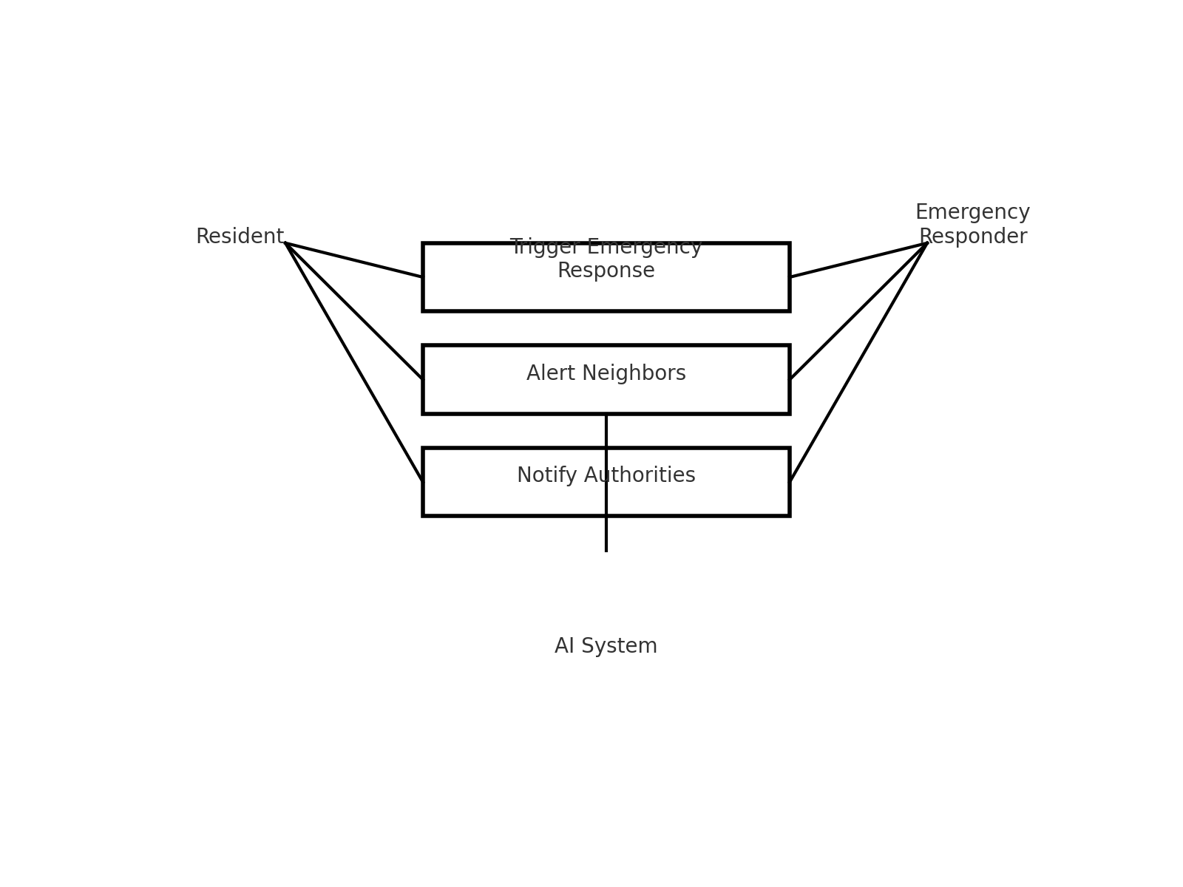
UML DIAGRAMS
Fig. No.4. Use Case Diagram
1159- Thanush
1131- Santhosh
AI-INTEGRATED HOME AND COMMUNITY PROTECTION SYSTEM SUPPORT SDG 11
13/17

Slide 14
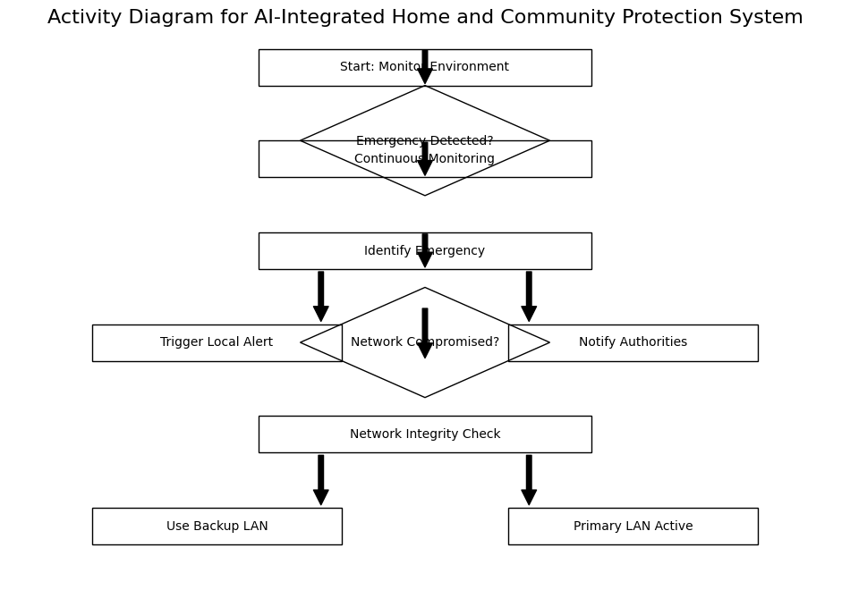
UML DIAGRAMS
Fig. No.5. Activity Diagram
1159- Thanush
1131- Santhosh
AI-INTEGRATED HOME AND COMMUNITY PROTECTION SYSTEM SUPPORT SDG 11
14/17

Slide 15
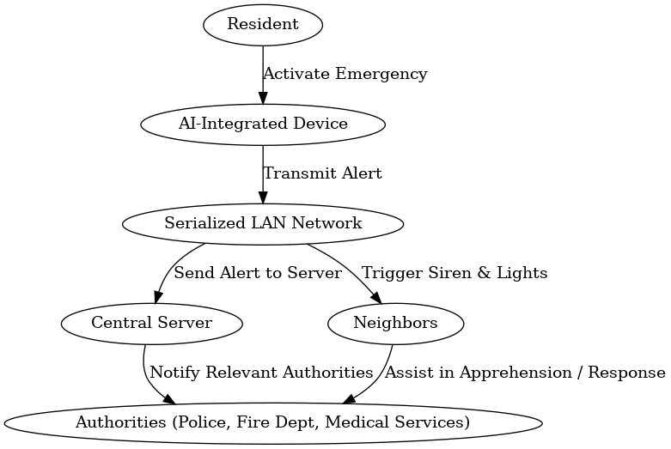
UML DIAGRAMS
Fig. No.6. Sequential Diagram
1159- Thanush
1131- Santhosh
AI-INTEGRATED HOME AND COMMUNITY PROTECTION SYSTEM SUPPORT SDG 11
15/17

Slide 16
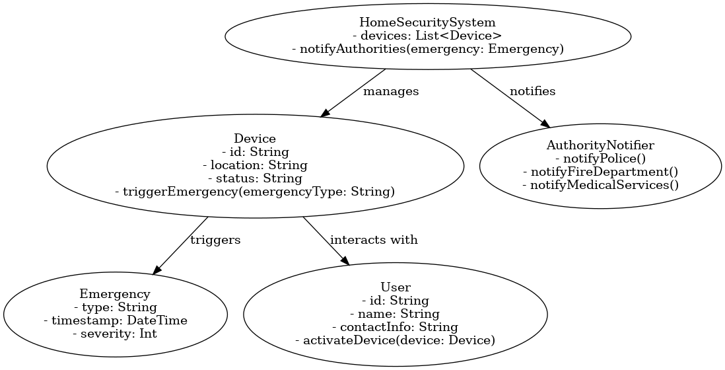
UML DIAGRAMS
Fig. No.7. Class Diagram
1159- Thanush
1131- Santhosh
AI-INTEGRATED HOME AND COMMUNITY PROTECTION SYSTEM SUPPORT SDG 11
16/17

Slide 17
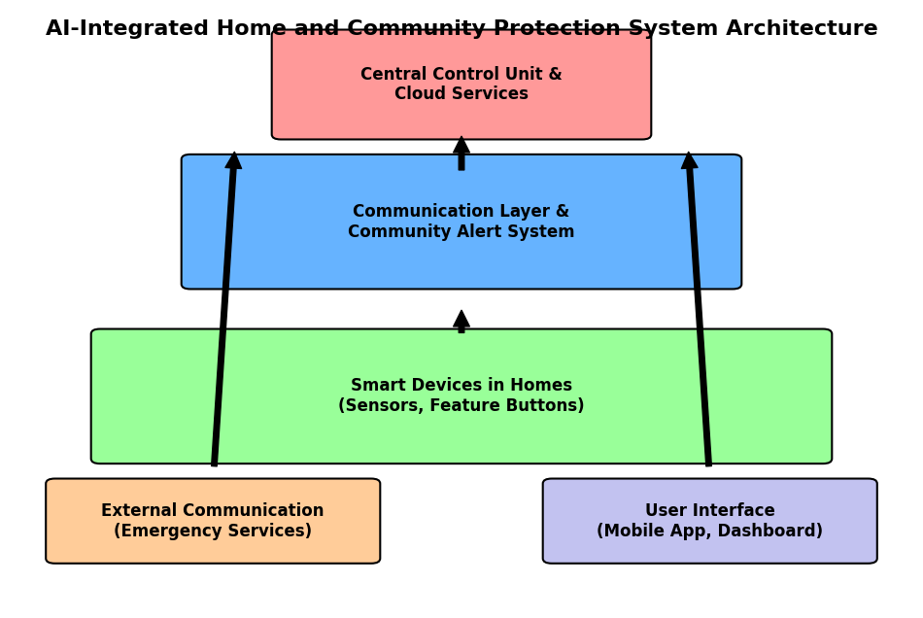
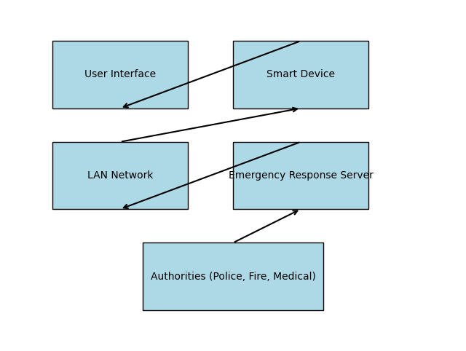
UML DIAGRAMS
Fig. No.8. Architecture
1159- Thanush
1131- Santhosh
AI-INTEGRATED HOME AND COMMUNITY PROTECTION SYSTEM SUPPORT SDG 11
17/17

